Slide 1
COURSE NAME – Cloud and devops COURSE CODE:22CS2243F Cohort-E27 (SEDP) Software engineering mis and Devops prepared by :Anjaneyulu.g
TOPIC:
JENKINS USING GIT

Slide 2



AIM OF THE SESSION
To familiarize students with the basic concept of devops life cycle
INSTRUCTIONAL OBJECTIVES
This Session is designed to:
Demonstrate about installation of jenkins
Describe about advantages of continuous integration
List out the step by step process to build a job in jenkins
Describe about benefits of maven
LEARNING OUTCOMES
At the end of this session, you should be able to:
Define continuous integration and its principles
Describe Importance of jenkin
Summarize about git and maven

Slide 3
Continuous integration
In simple words, CI is a software engineering practice where each check-in made by a developer is verified by either of the following:
Pull mechanism: Executing an automated build at a scheduled time.
Push mechanism: Executing an automated build when changes are saved in the repository
This step is followed by executing a unit test against the latest changes available in the source code repository:

Slide 4
CONTINUOUS INTEGRATION
Continuous integration is a development practice that requires developers to integrate code into a shared repository several times a day.
Each check-in is then verified by an automated build, allowing teams to detect problems early
CI is a significant part and in fact a base for the release-management strategy of any organization that wants to develop a DevOps culture.
Following are immediate benefits of CI:
Automated integration with pull or push mechanism
Repeatable process without any manual intervention
Automated test case execution

Slide 5
CONTINUOUS INTEGRATION
Coding standard verification
Execution of scripts based on requirement
Quick feedback: build status notification to stakeholders via e-mail
Teams focused on their work and not in the managing processes

Slide 6
Best practices : continuous integration implementation
Maintain a code repository such as Git or SVN.
Check-in third-party JAR files, build scripts, other artifacts, and so on into the code repository.
Execute builds fully from the code repository: Use a clean build.
Automate the build using Maven or Ant for Java.
Make the build self-testing: Create unit tests.
Commit all changes at least once a day per feature.
Every commit should be built to verify the integrity of changes.
Authenticate users and enforce access control (authentication and authorization).
Use alphanumeric characters for build names and avoid symbols.
Keep different build jobs to maintain granularity and manage operations in a better way.

Slide 7
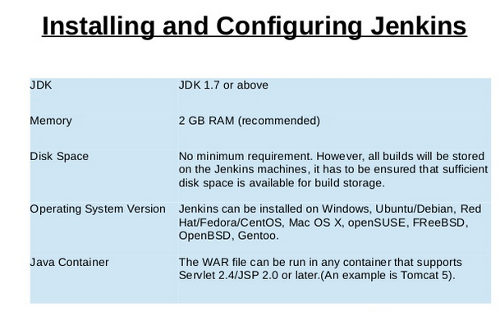

Slide 8
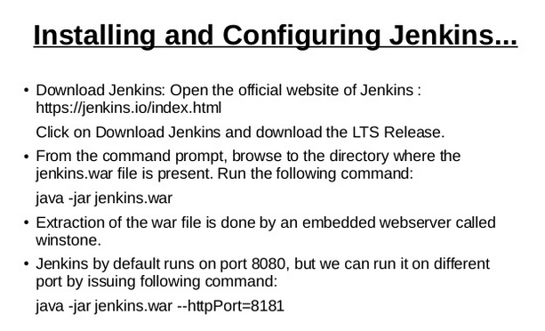

Slide 9
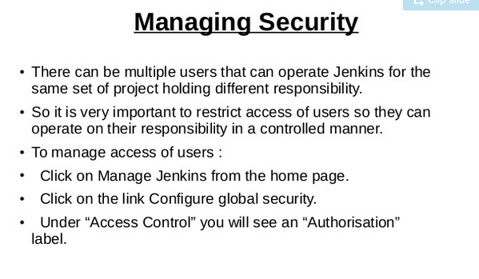

Slide 10
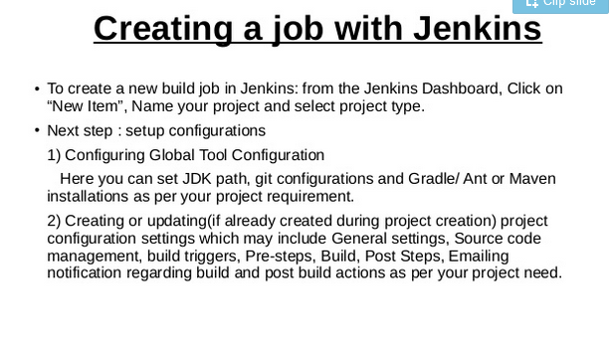

Slide 11
In simple words, CI is a software engineering practice where each check-in made by a developer is verified by either of the following:
Pull mechanism: Executing an automated build at a scheduled time
Push mechanism: Executing an automated build when changes are saved in the repository
This step is followed by executing a unit test against the latest changes available in the source code repository.
Jenkins doesn't need the introduction; it is an open source and one the most popular CI tools available in the market. It helps in automating the repetitive task of CI.
Jenkins makes the process effective and transparent.

Slide 12
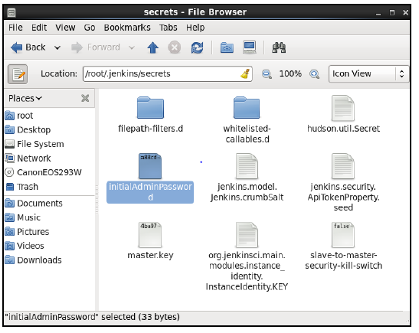

Slide 13
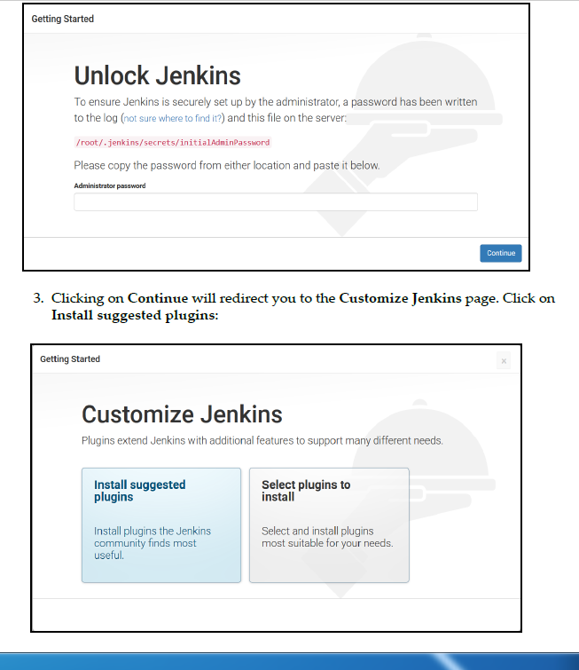

Slide 14
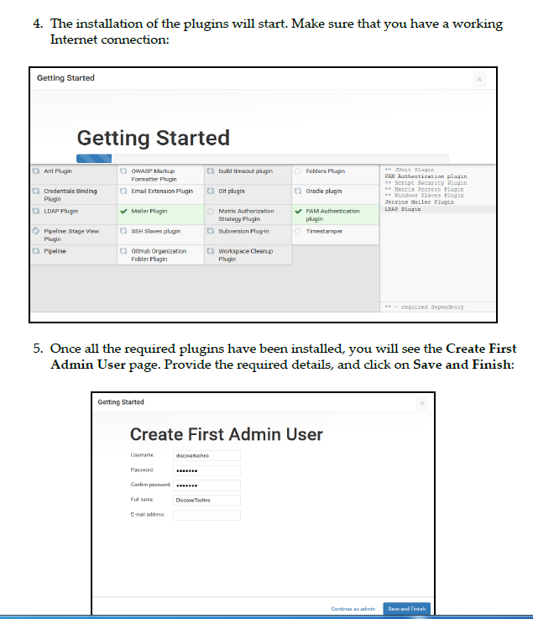

Slide 15
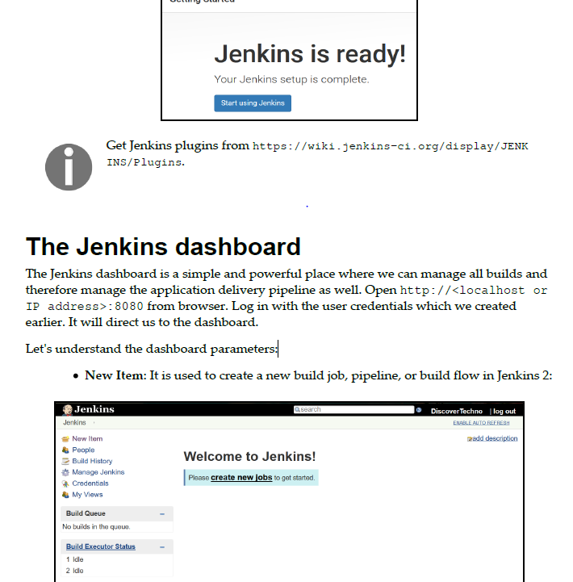
6. Jenkins is ready! Our Jenkins setup is complete. Click on Start using Jenkins:

Slide 16
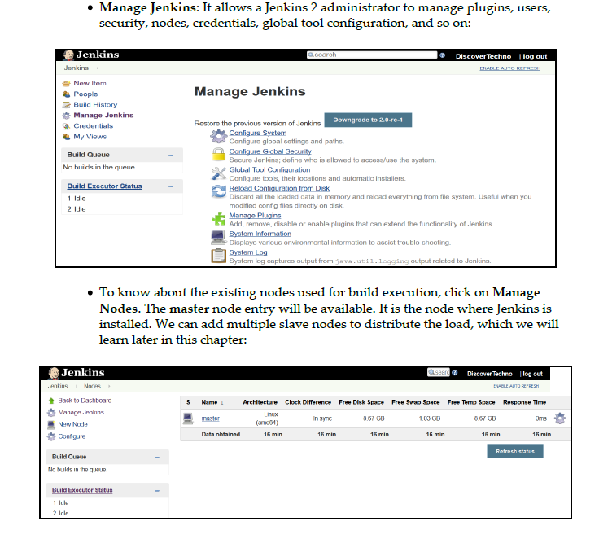

Slide 17
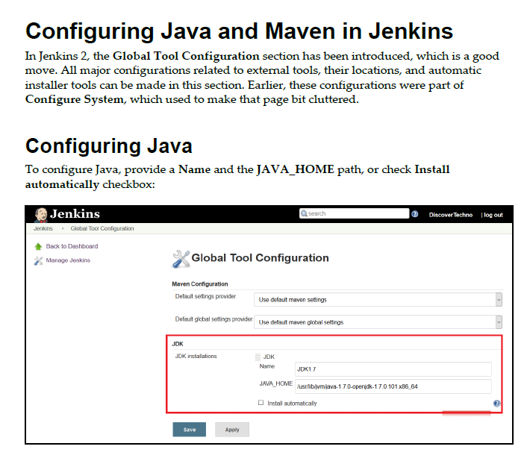

Slide 18
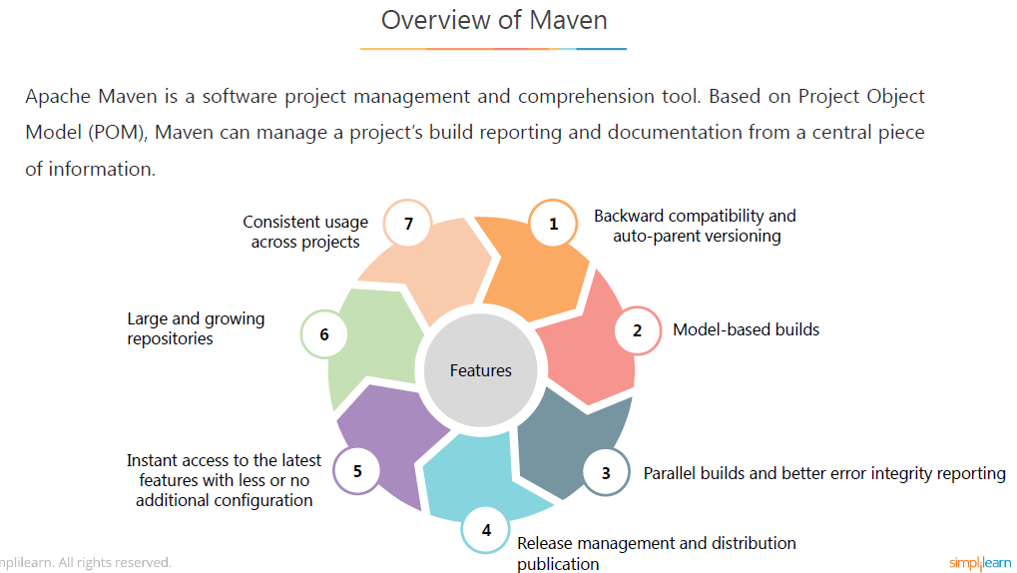

Slide 19
Configure Jenkins and Maven
Login to your Ubuntu lab provided with the course.
Login to Jenkins and create the first Jenkins job.
Install and configure Maven.
Configure Jenkins with Java, Git, and Maven.
Create a Jenkins job for your maven build project and run the project.
Poll Git for commits and automatically trigger the build.
Build the trigger using Push mechanism instead of Pull.
Repeat steps 6 and 7 multiple times to observe the results at console output section.

Slide 20
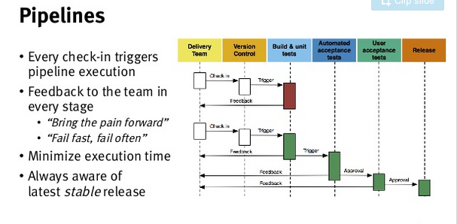

Slide 21



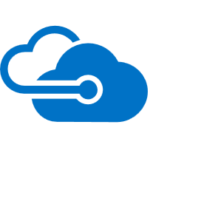
Continuous Delivery
SOURCE CONTROL
CI
PACKAGE
PIPELINE
DEPLOYMENT
OctoPack
Octopus Deploy ASP.NET Web App

Slide 22
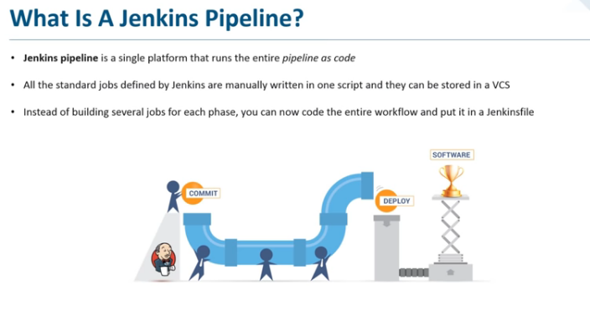

Slide 23
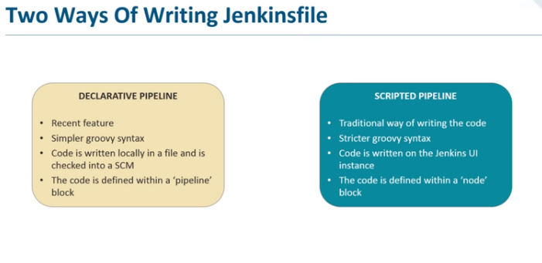
Two ways of writing Jenkins file

Slide 24
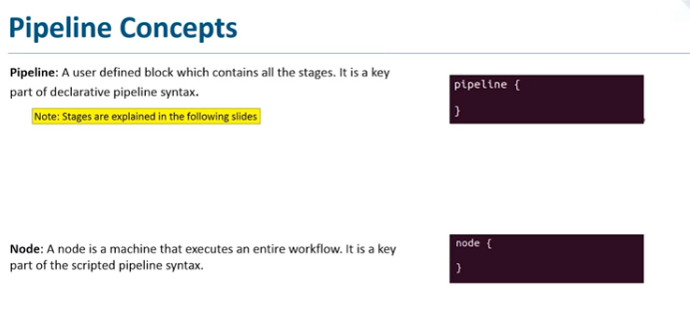
PIPELINE CONCEPT

Slide 25
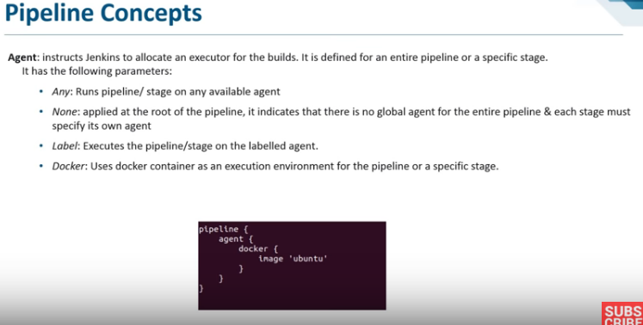

Slide 26
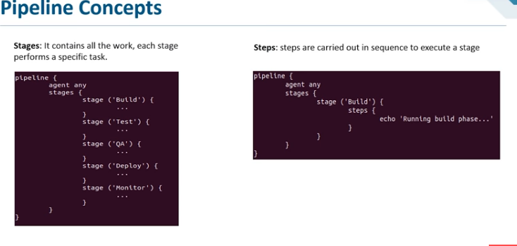

Slide 27
Pipeline concept
Open Jenkins
Go the Newitem
Give a name and select pipeline
Go to configure window and in that select the pipeline
there are two ways to give a pipeline
Select from SCM- and give git the url which is already have the code-- https://github.com/Zulaikha12/git-test
Give the name in script path as jenkinsfile
Build the program file

Slide 28
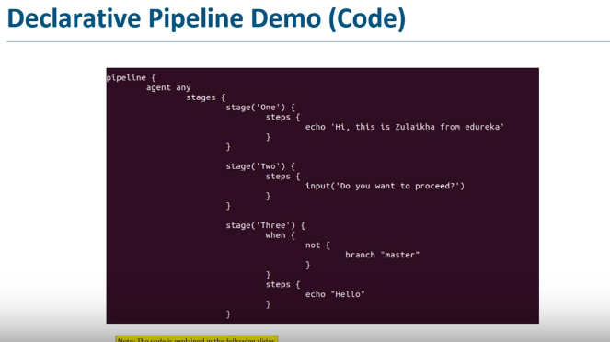
DECLARATIVE PIPELINE

Slide 29
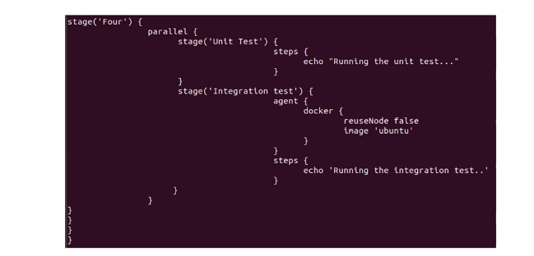
Declarative pipeline

Slide 30
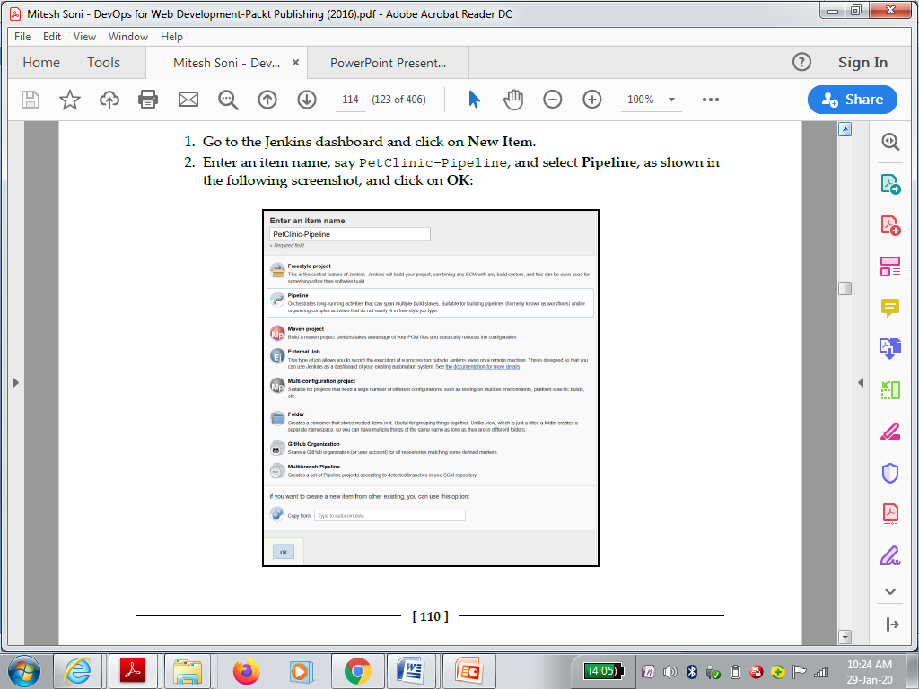

Slide 31
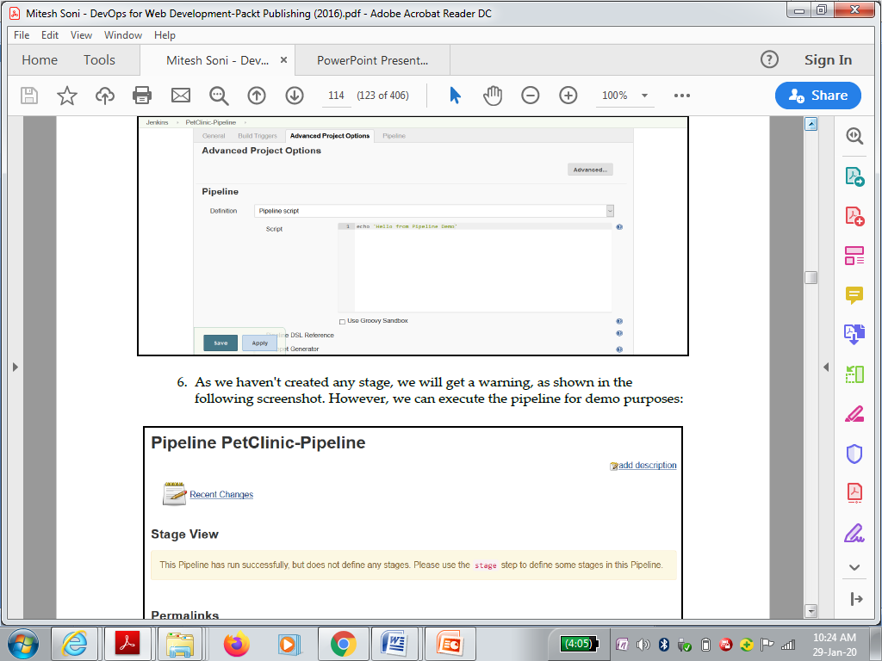

Slide 32
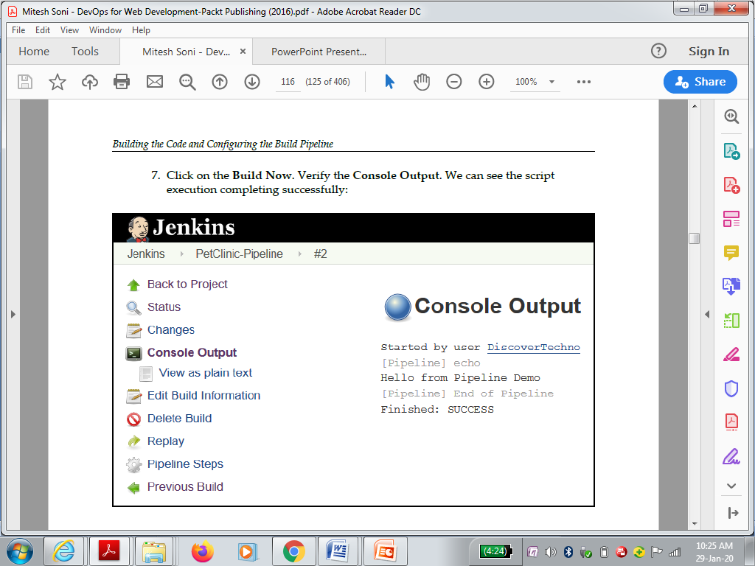

Slide 33
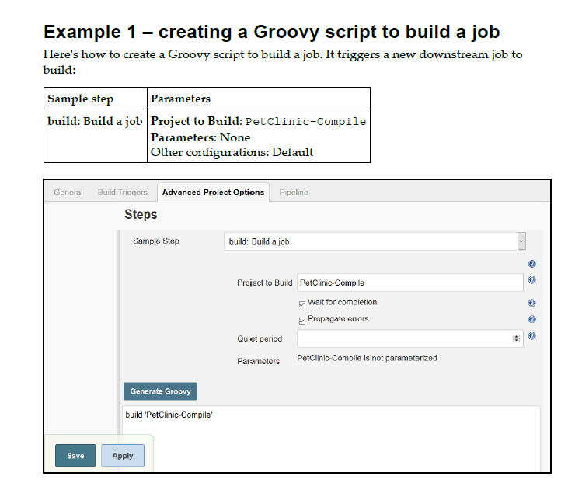

Slide 34
SELF-ASSESSMENT QUESTIONS
What is Continuous Integration (CI), and why is it important in software development?
Explain the role of Jenkins in a CI/CD pipeline.
How does Jenkins facilitate automation in the CI process?
Describe the typical workflow of a Jenkins CI pipeline.
What are the key benefits of using Jenkins for CI?
How does Jenkins handle concurrent builds and ensure build consistency?
Define Maven.List out the steps for Jenkins Installation
Explain overview of Maven.
Explain process of configuring maven and jenkins

